Slide 1
Computational analysis of cancer spheroid invading the mesothelium
Phoebe Lim
Supervisor: Prof Low Boon Chuan
Collaborating Advisor: Tetsuya Hiraiwa
Mentors: Selwin Wu, Lou Yuting
Notes:
Good morning Prof Greg and Selwin, today I’ll be presenting on my UROPS project titled “Computational analysis of cancer spheroid invading the mesothelium”.
Bibliography: https://zbib.org/23cff151210848079e92288ea8077961

Slide 2
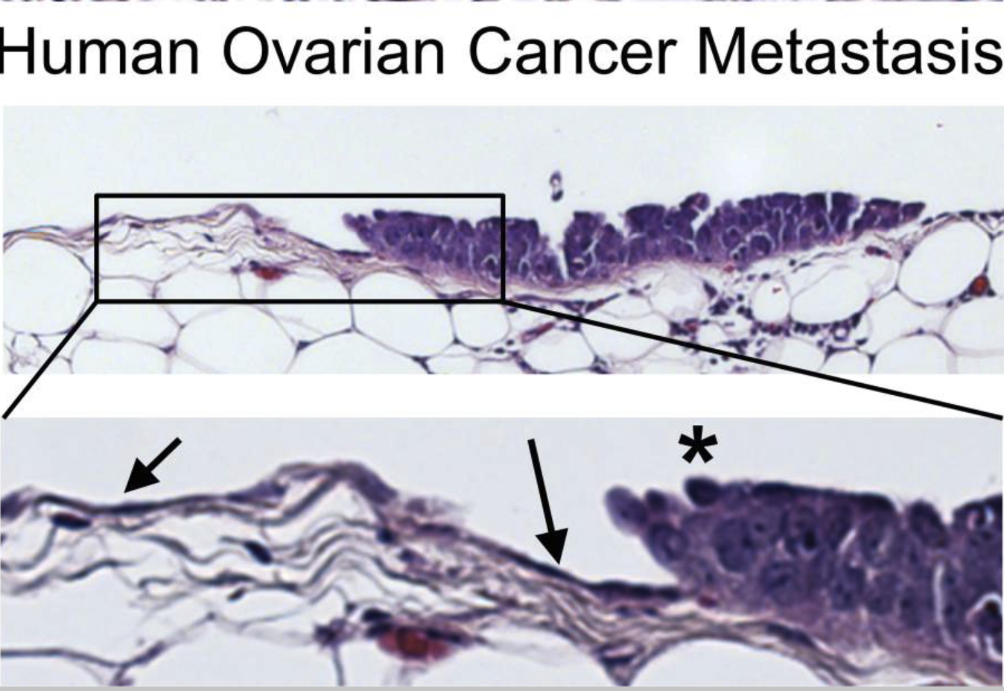
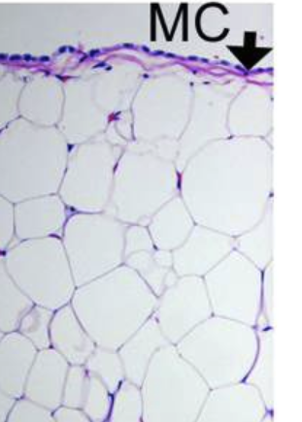
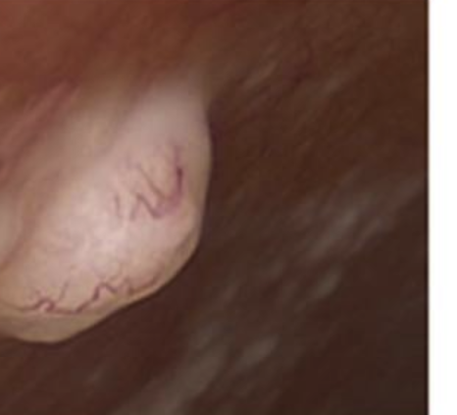
Cross-sections of ovarian cancer metastasis in patients
Normal
Human
Omentum
Peritoneal Metastasis
Mesothelial cells
Adipose tissue
Lengyel., Am J Pathol 2010
Kenny et al., Cancer Discov 2011
The mesothelium is an early protective barrier against tumour metastatic colonisation.
Notes:
Let me start by briefly explaining the pattern of metastasis in ovarian cancer. Shown here are cross-sections of ovarian cancer metastasis in patients. The mesothelium (left) covers the adipose tissue in a normal human omentum. It has been found that tumour implants (centre) typically attach to and invade the mesothelial cell layers but rarely invade deeper into the peritoneum. Mesothelium invasion can also be seen from the figure on the right, where mesothelial cells (arrows) are observed to line the abdominal surface but are not detected under the proliferating ovarian cancer cell implant (asterisk). Hence, these results show that the mesothelium acts as an early protective barrier against the metastatic colonisation of ovarian cancer tumours.
Omentum: Large flat adipose tissue layer covered by visceral peritoneum that hangs down from the greater curve of the stomach.
Peritoneum: Membrane that covers the inner lining of the abdominal cavity and the organs lying in there.
Mesothelium invasion occurs when cancer spheroids adhere to the mesothelial monolayer and trigger disassembly and migration of the cell matrix, initiating tearing of the mesothelium.
(from left to right: H&E stain of normal omentum, peritoneal implant with neoangiogenesis, H&E-stained microscopic tumour implant on the omental surface from a patient with metastatic serous ovarian carcinoma)
Slide credit: Selwin
References:
Kenny, H. A., Nieman, K. M., Mitra, A. K., & Lengyel, E. (2011). The first line of intra-abdominal metastatic attack: Breaching the mesothelial cell layer. Cancer Discovery, 1(2), 100–102. https://doi.org/10.1158/2159-8290.CD-11-0117
Lengyel, E. (2010). Ovarian cancer development and metastasis. The American Journal of Pathology, 177(3), 1053–1064. https://doi.org/10.2353/ajpath.2010.100105

Slide 3
An in-vitro modular approach to model the initial stages of metastatic colonisation
1. ATTACHMENT of ovarian cancer spheroid.
2. Myosin II- and integrin-mediated spheroid cell intercalation and outward migration of mesothelial cells.
3. Accessing and spreading on submesothelial ECM and MESOTHELIAL CLEARANCE.
Iwanicki et al., Cancer Discov 2011
Davidowitz et al., JCI 2014
Kenny et al., JCI 2014
Kenny et al., JCI 2008
Although the biomedical and clinical relevance of the system is well studied, the underlying pattern of cell dynamics remains unclear.
Notes:
Here is a depiction of how ovarian cancer spheroids invade the mesothelial layer, as found in previous studies.
Given that the underlying pattern of cell dynamics during spheroid invasion remains unclear, my project aimed to find out whether there is a difference in cell migration between invading and non-invading spheroids.
Submesothelial: just beneath mesothelial surface
Slide credit: Kang Wei
References:
Davidowitz, R. A., Selfors, L. M., Iwanicki, M. P., Elias, K. M., Karst, A., Piao, H., Ince, T. A., Drage, M. G., Dering, J., Konecny, G. E., Matulonis, U., Mills, G. B., Slamon, D. J., Drapkin, R., & Brugge, J. S. (2014). Mesenchymal gene program–expressing ovarian cancer spheroids exhibit enhanced mesothelial clearance. Journal of Clinical Investigation, 124(6), 2611–2625. https://doi.org/10.1172/JCI69815
Iwanicki, M. P., Davidowitz, R. A., Ng, M. R., Besser, A., Muranen, T., Merritt, M., Danuser, G., Ince, T., & Brugge, J. S. (2011). Ovarian cancer spheroids use myosin-generated force to clear the mesothelium. Cancer Discovery, 1(2), 144–157. https://doi.org/10.1158/2159-8274.CD-11-0010
Kenny, H. A., Chiang, C.-Y., White, E. A., Schryver, E. M., Habis, M., Romero, I. L., Ladanyi, A., Penicka, C. V., George, J., Matlin, K., Montag, A., Wroblewski, K., Yamada, S. D., Mazar, A. P., Bowtell, D., & Lengyel, E. (2014). Mesothelial cells promote early ovarian cancer metastasis through fibronectin secretion. The Journal of Clinical Investigation, 124(10), 4614–4628. https://doi.org/10.1172/JCI74778
Kenny, H. A., Kaur, S., Coussens, L. M., & Lengyel, E. (2008). The initial steps of ovarian cancer cell metastasis are mediated by MMP-2 cleavage of vitronectin and fibronectin. Journal of Clinical Investigation, 118(4), 1367–1379. https://doi.org/10.1172/JCI33775

Slide 4
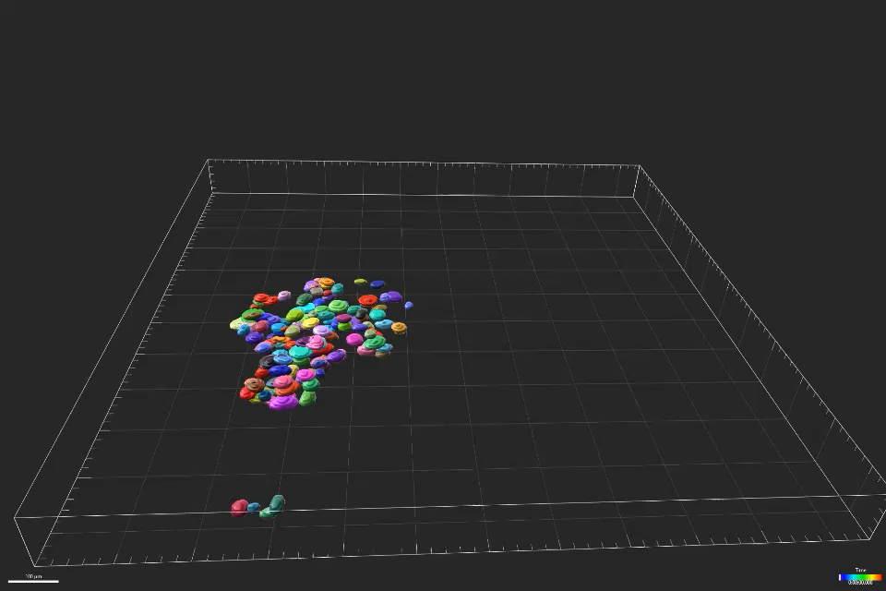
Motivation
To better understand the pattern of cell migration during spheroid invasion of the mesothelium.
Notes:
Here is a movie to illustrate spheroid invasion of the mesothelial layer (mesothelium not shown). [as the movie plays] We can see that the cells in the spheroid are spreading outwards, but from our naked eye alone it is difficult to precisely tell whether these cells are moving towards a particular direction, and whether the cells are moving collectively as a cluster. Therefore, the motivation of my project was to make sense of the dynamics of cells in spheroids to better understand how tumour spheroids push through the mesothelium as shown in the previous slide. Specifically, I wanted to gain a better understanding of the pattern of cell migration during spheroid invasion.
Movie credit: Selwin and Celestine

Slide 5
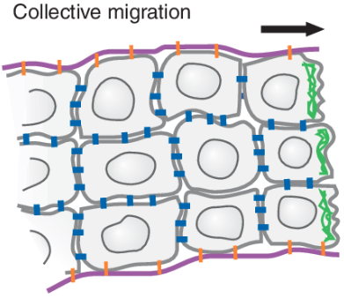
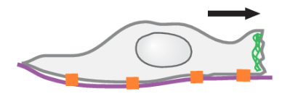
Aim
To quantify cell migration during spheroid invasion of the mesothelium.
Do individual cells in invading spheroids undergo directed cell migration?
Do cells in invading spheroids migrate collectively?
(within a spheroid)
Single cell directed migration
(within a spheroid)
Kunwar et al., Ann Review of Cell and Developmental Biology 2006
Notes:
It is important to note here that for the first question, the directed migration I am quantifying is that of single cells within a spheroid, whereas for the second question, I am looking at a cluster of cells and whether they are observed to move together.
References:
1. Kunwar, P. S., Siekhaus, D. E., & Lehmann, R. (2006). In vivo migration: A germ cell perspective. Annual Review of Cell and Developmental Biology, 22(1), 237–265. https://doi.org/10.1146/annurev.cellbio.22.010305.103337

Slide 6
Aim
To quantify cell migration during spheroid invasion of the mesothelium.
Do individual cells in invading spheroids undergo directed cell migration?
Do cells in invading spheroids migrate collectively?
(within a spheroid)
Single cell directed migration
(within a spheroid)
Kunwar et al., Ann Review of Cell and Developmental Biology 2006

Slide 7
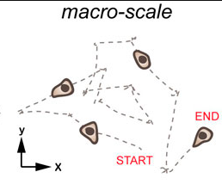
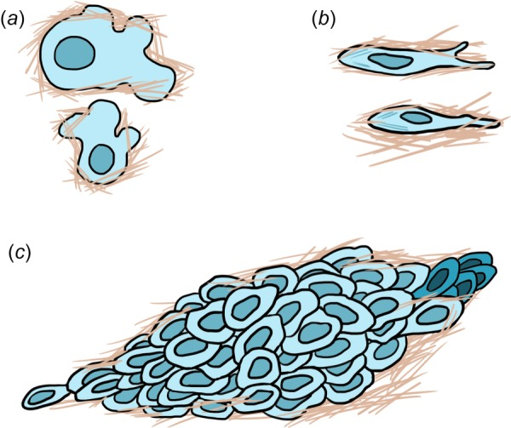
What is the significance of directed cell migration?
Directed cell migration is the movement of individual cells in a particular direction
Successful tumour invasion is largely dependent on the directed migration of cancer cells through the ECM and tissues
Amoeboid vs mesenchymal migration
Lintz et al., Journal of Biomechanical Engineering 2017
Pawluchin & Galic, Frontiers in Cell and Developmental Biology 2022
Notes:
Let me first explain what directed cell migration is. It is the movement of individual cells in a particular direction (left) and is typically mediated by chemical signals. Single cancer cells are thought to utilise two main modes of migration, namely amoeboid and mesenchymal migration (right). Amoeboid migration is characterized by blebbing, weak adhesions, and rapid motility whereas mesenchymal migration is characterized by strong stress fibers and slow speed. In many cases, successful tumour invasion is dependent on the directed migration of cancer cells through the ECM and tissues.
Amoeboid migration is primarily employed by cells moving through paths and pores in the ECM, as the cells deform through the pores and fibers. In contrast, mesenchymal migration results in the generation or expansion of paths as cells degrade the surrounding matrix.
Blebbing: “blister-like” morphology
Stress fibers: contractile actin fibers found in non-muscle cells
References:
Lintz, M., Muñoz, A., & Reinhart-King, C. A. (2017). The mechanics of single cell and collective migration of tumor cells. Journal of Biomechanical Engineering, 139(2), 0210051–0210059. https://doi.org/10.1115/1.4035121
Pawluchin, A., & Galic, M. (2022). Moving through a changing world: Single cell migration in 2D vs. 3D. Frontiers in Cell and Developmental Biology, 10. https://www.frontiersin.org/articles/10.3389/fcell.2022.1080995

Slide 8
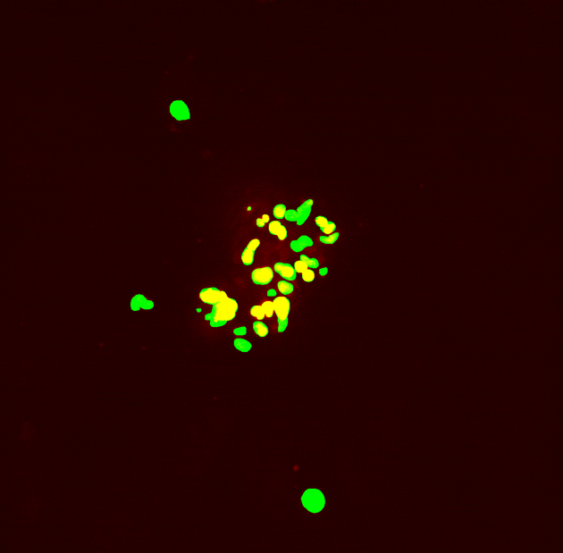
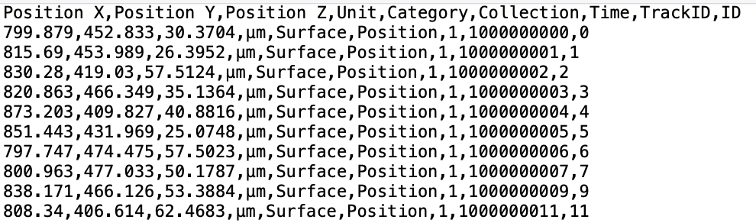
How was cell position data obtained from invading and non-invading spheroids?
4 invading samples, 3 non-invading samples
Tracked position data
Cell segmentation using StarDist and tracking using Imaris
Notes:
To answer the question of whether individual cells in invading spheroids undergo directed cell migration, I would first need to determine the changes in position of the cells. I was given four invading spheroid samples and three non-invading samples. Segmentation and tracking were done prior to my analysis to identify individual spheroids and track their movement in the 3-dimensional space. The obtained tracked position data was then used for analysis. Here is a snippet of the tracked position data from a single sample. I focused on 5 columns in the position data, namely Positions X, Y and Z (representing coordinate positions in the 3D space), Time (typically in intervals of 3 min) and TrackID (unique cell identifier).
Image credit: Celestine
Segmentation and tracking done by Celestine and Daniella

Slide 9
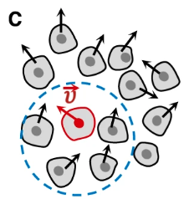
How was cell motion identified from the given position data?
Calculate velocity for each axis to obtain a 3D vector
Relative velocity taken to eliminate the effect of drift
Normalise velocity to single out direction of cell motion
Lenne & Trivedi, Nature Communications 2022
Notes:
Next, from the cell position data, I was interested in extracting information on cell motion in the spheroids. To do this, I first calculated cell velocity by taking the change in distance over time for all three axes. Then, relative velocity was obtained by subtracting centroid velocity from absolute velocity. This was done to eliminate the effect of drift, which is an overall shift in translational position of the cell. Drift occurs because cells are not always stationary, and we can think of them as constantly floating around the centre of the spheroid. Finally, normalisation was done to ignore the magnitude of the velocity and single out the direction in which each cell was moving in.
Centroid velocity: mean position across all 3 axes
References:
1. Lenne, P.-F., & Trivedi, V. (2022). Sculpting tissues by phase transitions. Nature Communications, 13(1), 664. https://doi.org/10.1038/s41467-022-28151-9

Slide 10
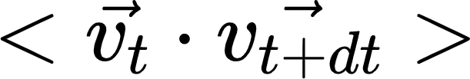
Do cells in invading spheroids undergo directed cell migration?
Temporal autocorrelation analysis to find out whether directed cell migration occurs.
For each sample:
Choose a value of Δt, e.g. 1 unit
Calculate cell velocity at time t and t + Δt
Calculate inner product,
between the two velocities
for each cell
and timepoint
Notes:
To decompose the term “temporal autocorrelation”, what it means is that I was concerned with correlation of individual cells ”auto” over time “temporal”. dt here represents lag time, or simply the length of time between any two timepoints. Let’s take dt=1 as an example. For the first cell, at the first timepoint t=1, the velocity at t=1 and t=2 would be calculated. Next, I would calculate the inner product between these two vectors. Let me go into the relevance of inner product in the next slide.

Slide 11
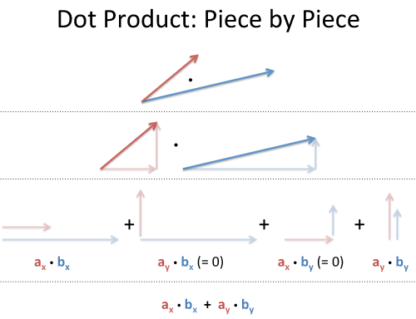
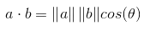
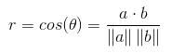
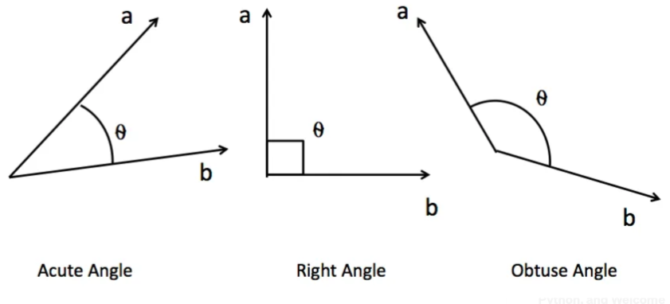
How was the relationship between the direction of cell motion quantified?
Inner product, or dot product, indicates the relationship between a cell’s direction of motion at two different timepoints.
Better Explained
Suga, Medium 2018
Notes:
Inner product, or dot product, indicates the relationship between a cell’s direction of motion at two different timepoints. Here is a pictorial representation of dot product in the 2D space. We can think of dot product as a method of directional multiplication to relate the x and y components of two vectors. [referring to diagram] Here, we are relating first the x components of the vectors, followed by the y components, then finally adding them up. In my calculations, I performed this same method but with a z component.
From the geometric expression of inner product (point to formula), we can see that the inner product of two normalised vectors can be interpreted as a correlation value, that is, when the angle between the vectors is acute, cos(theta) is positive, and at obtuse angles, cos(theta) is negative.
References:
Better Explained. (n.d.). Vector calculus: Understanding the dot product. Retrieved March 31, 2023, from https://betterexplained.com/articles/vector-calculus-understanding-the-dot-product/
Suga, N. (2018, September 14). Geometric interpretation of the correlation between two variables. Medium. https://medium.com/@ns2586/geometric-interpretation-of-the-correlation-between-two-variables-4011fb3ea18e

Slide 12
Do cells in invading spheroids undergo directed cell migration?
Temporal autocorrelation analysis to find out whether directed cell migration occurs.
Indicates the relationship between a cell’s direction of motion at two different timepoints.
For each sample:
Choose a value of Δt, e.g. 1 unit
Calculate cell velocity at time t and t + Δt
Calculate inner product,
between the two velocities
for each cell
and timepoint
Repeat for a specified range of Δt
Take average over all cells and timepoints
Notes:
After obtaining the inner product between the two velocities, this process would be repeated for t=2, t=3, t=4 and so on. Then this would be done for all the cells in the spheroid and the average would be taken over all cells and timepoints, to obtain a value that summarises how the motion of the cells are related to their motion at previous timepoints. This was done for multiple values of dt to find out whether individual cell motion persisted over time.

Slide 13

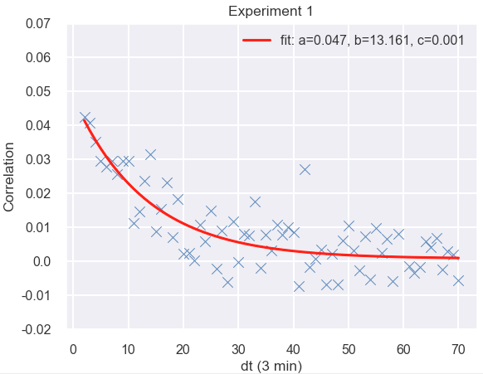
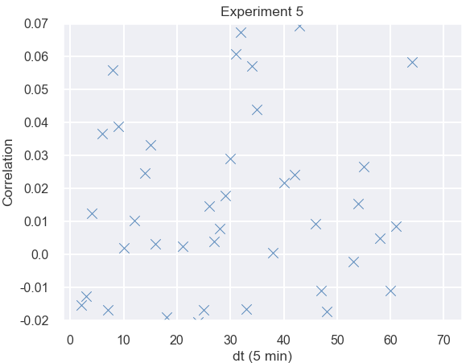
Do cells in invading spheroids undergo directed cell migration?
Invading (fitted to )
Non-invading
Cell-directed migration is observed in invading spheroids but not in non-invading spheroids.
Notes:
Using the correlation values obtained for different values of dt, I plotted graphs of correlation against lag time and fitted the data to exponential decay curves. These two graphs here reflect a single sample each but are representative of the invading and non-invading spheroids respectively. Here, larger correlation values indicate that the cells are moving in a similar direction over time, whereas negative correlation values indicate that the cells are moving in opposite directions. First, let’s look at the difference in the autocorrelation function between invading and non-invading samples. All the invading samples could be fitted to an exponential decay curve, whereas the correlation values for the non-invading samples fluctuated around 0, indicating an absence of any directed motion over time.
[click] I’ll focus on the first part of the graph in my explanation on the next slide.

Slide 14
Do cells in invading spheroids undergo directed cell migration?
Invading
Non-invading
Cell-directed migration is observed in invading spheroids but not in non-invading spheroids.
Notes:
Here is a simple diagram to illustrate this observation. The arrows represent velocities at different timepoints. What this result implies is that cells in invading spheroids (as shown on the left) have velocities that are strongly correlated with each other at short timescales. In contrast, a cell in a non-invading spheroid (shown on the right) would be moving randomly, with velocities at consecutive timepoints being uncorrelated. Therefore, my results show that cell migration in invading spheroids is directed. In comparison, cells in non-invading spheroids move randomly.
Cell-directed migration could lead to an increase in the fluidity of the system, resulting in superdiffusive behaviour that aids spheroid invasion.

Slide 15
Do cells in invading spheroids undergo directed cell migration?
Invading (fitted to )
Pawluchin & Galic, Frontiers in Cell and Developmental Biology 2022
Cell-directed migration is observed in invading spheroids but not in non-invading spheroids.
Notes:
Next, I will explain the reason for this decay in correlation at longer timescales. If we look at the diagram here and compare this starting vector with a vector at the next timepoint, we can tell that they are more correlated as compared to the starting vector and a vector at a timepoint further away.

Slide 16
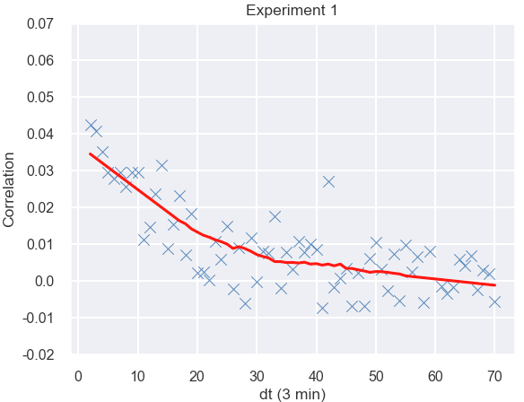
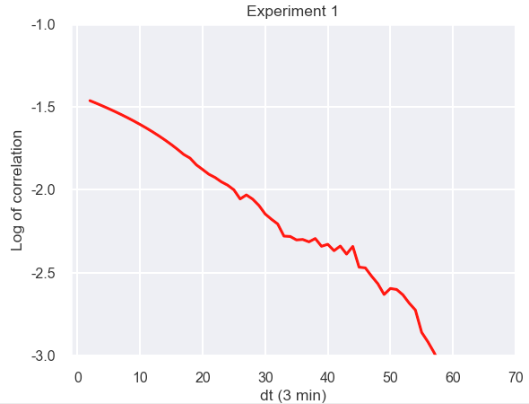
How long does this directed migration last for?
Smooth data using Savitzky-Golay filter (window length = 31, polynomial order = 1)
Take common logarithm (log₁₀) of smoothed data
Plot graphs of log of correlation against Δt
Notes:
Next, I wanted to find out how long this directed motion lasts for in invading spheroids. This was done by first, smoothing the data using a Savitzky-Golay filter, which is a processing method for noisy signals. It fits successive sub-sets of adjacent data points with a low-degree polynomial by the method of linear least squares. In this case, I used a window length of 31 and fitted the data to a linear polynomial. These parameters were determined to give the best smoothing results after trying out a few different values. Then, I took the common logarithm (log base 10) of the smoothed data (to get an approximately linear plot as shown on the right) and plotted the log plots of all the samples on the same axes.
Purpose of smoothing: exponential was not exactly the best fit to the data points

Slide 17
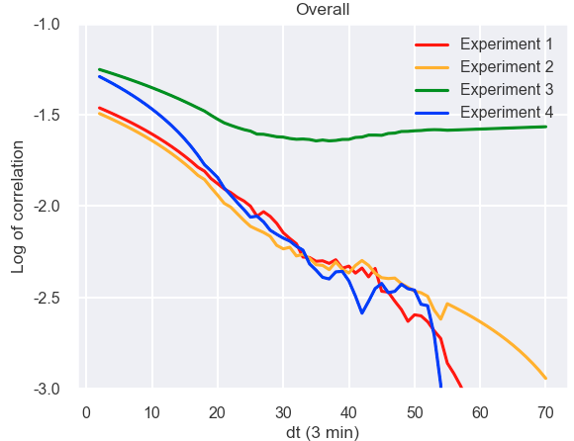
How long does this directed migration last for?
A linear curve was fitted to each of the curves for the first 20 values of Δt.
Analysis of the characteristic timescale of this plot shows that directed migration lasts for around 129 minutes.
Notes:
Here is the resulting graph of correlation against lag time in the log scale. The graph shown earlier is reflected in the red line that represents Experiment 1. In order to know how long this directed motion persists for, the characteristic timescale of this plot can be analysed. This is done by fitting a linear curve at short timescales (taking into account that there may be outliers at longer timescales, such as Experiment 3), in this case the first 20 values of dt, calculating its gradient, and then taking the negative reciprocal.

Slide 18
Is there a difference in the duration of directed migration between the top and bottom of spheroids?
Cancer spheroids are observed to invade and spread on the mesothelium from the bottom
Separating spheroids into the top and bottom would provide a better understanding of the difference in regional cell dynamics
Iwanicki et al., Cancer Discov 2011
Notes:
After looking at the spheroid as a whole, I wanted to find out whether there was a difference in the duration of directed motion between the top and bottom of spheroids. To do this, I separated the top and bottom of spheroids based on their median position on the z-axis (slice spheroid). Given that cancer spheroids invade and spread on the mesothelium from the bottom, we would expect to see a regional difference in directed cell motion.

Slide 19
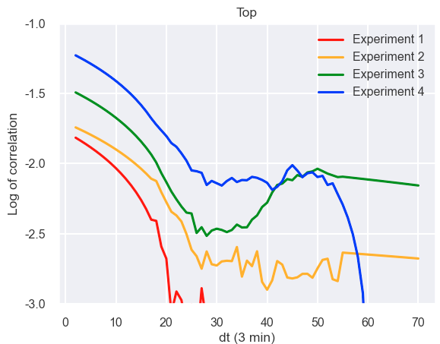
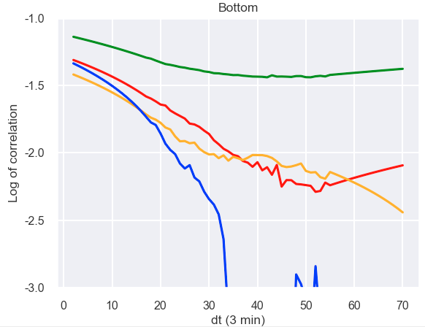
Is there a difference in the duration of directed migration between the top and bottom of spheroids?
Cell-directed migration lasts for a longer duration in the bottom of spheroids (155 minutes on average) as compared to the top of spheroids (87.7 minutes on average).
Notes:
Upon carrying out the same characteristic timescale analysis mentioned earlier, we can see that the bottom of the spheroid has a longer duration of directed motion than the top. In particular, cell-directed migration lasts for 155 mins in the bottom of spheroids and 87.7 mins in the top of spheroids. This supports experimental observations that the bottom of the spheroid is the part undergoing invasive spreading.

Slide 20
Aim
To quantify cell migration during spheroid invasion of the mesothelium.
Do individual cells in invading spheroids undergo directed cell migration?
Do cells in invading spheroids migrate collectively?
(within a spheroid)
Single cell directed migration
(within a spheroid)
Kunwar et al., Ann Review of Cell and Developmental Biology 2006

Slide 21
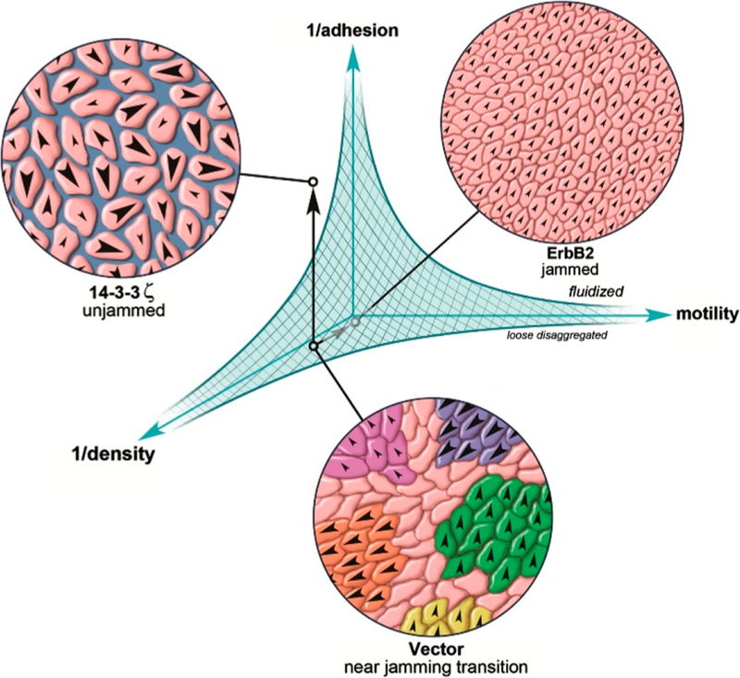
What is the significance of collective cell migration?
Collective cell migration involves a group of cells travelling together under certain patterns with a degree of coordination among the movement of individual cells
Reported to have a greater potential for metastasis
Useful to understand certain transitions in cancer tissues like jamming and unjamming
Spatarelu et al., ACS Biomaterials 2019
Yang et al., Am J Translational Research 2019
Lintz et al., Journal of Biomechanical Engineering 2017
Notes:
Before I move on to my methods of analysis, let me first explain what collective cell migration is and why it is significant. Collective cell migration involves a group of cells travelling together under certain patterns with a degree of coordination among the movement of individual cells. In cancer, collective cell migration (left) is thought to be fronted by a select few leader cells. In some types of cancer, collective cell migration has been reported to have a greater potential for metastasis. Understanding whether this occurs in invading spheroids would be useful towards the analysis of certain types of phase transitions like jamming and unjamming. Jamming is a phase transition in which the viscosity of the tissue increases with increasing cell density. In the jammed state, cells are thought to be confined in a solid-like cage.
References:
1. Spatarelu, C.-P., Zhang, H., Trung Nguyen, D., Han, X., Liu, R., Guo, Q., Notbohm, J., Fan, J., Liu, L., & Chen, Z. (2019). Biomechanics of collective cell migration in cancer progression: Experimental and computational methods. ACS Biomaterials Science & Engineering, 5(8), 3766–3787. https://doi.org/10.1021/acsbiomaterials.8b01428
2. Yang, Y., Zheng, H., Zhan, Y., & Fan, S. (2019). An emerging tumor invasion mechanism about the collective cell migration. American Journal of Translational Research, 11(9), 5301–5312. https://www.ncbi.nlm.nih.gov/pmc/articles/PMC6789225/

Slide 22
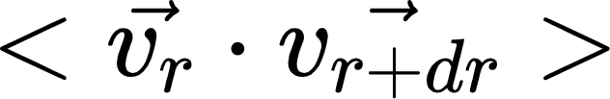
Do cells in invading spheroids migrate collectively?
Spatial correlation analysis to find out whether cell motion is correlated between different cells.
Indicates the relationship between the direction of motion of two different cells.
For each sample:
Calculate cell velocity
Calculate distance and inner product,
between the two velocities
Choose a timepoint
for each cell
for each pair of cells
classify inner product values based on distance
Plot graphs of correlation against distance
Take average correlation within each group
Notes:
Let’s take one timepoint as an example. For each cell in the spheroid, I would calculate its velocity as per the method mentioned earlier. Then, for every pair of cells in the spheroid, I would calculate their distance and inner product between their velocities. The inner product indicates the relationship between the direction of motion of two different cells. Next, these inner product values would be grouped based on the distance between the cells and the average would be taken over all cells in that group, to obtain a value that summarises how the motion of neighbouring cells are related. Lastly, I plotted graphs of correlation against distance to see if cells closer to one another have a better correlation than cells that are further apart.

Slide 23
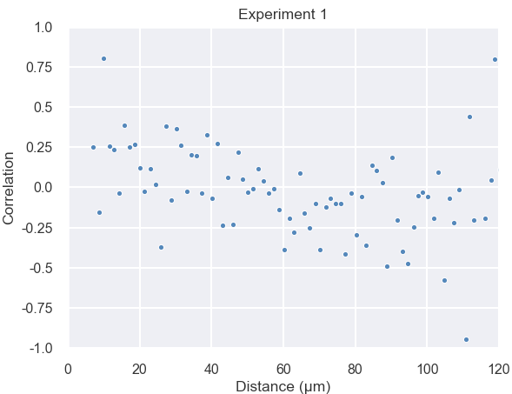
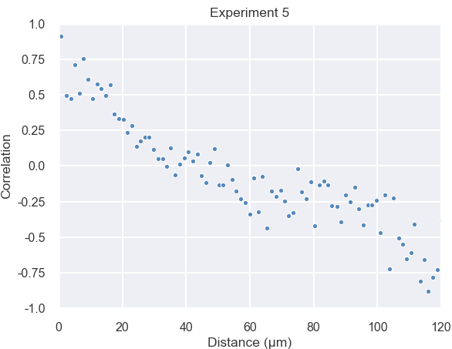
Do cells in invading spheroids migrate collectively?
Invading
Non-invading
Cells in non-invading spheroids migrate collectively.
Notes:
At a single point in time, this is how the graphs of correlation against distance would look like. The high correlation values for short distances in non-invading spheroids (right) show that the cells migrate collectively. In addition, this collective migration in non-invading spheroids is less pronounced for cells that are further apart. However, for invading spheroids, the correlation values mostly fluctuate around 0, showing a lack of correlation between the direction of movement of neighbouring cells. This could be due to two possibilities.
Top and bottom analysis not shown because: for invading spheroids, bottom correlation values were generally more scattered (but this was not uniform across all timepoints); and for non-invading spheroids, there was no significant difference between the top and bottom.

Slide 24
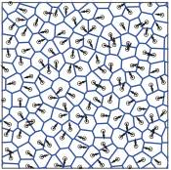
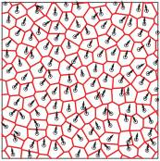
Do cells in invading spheroids migrate collectively?
Invading
Non-invading
Malinverno et al., Nature Materials 2017
Cells in non-invading spheroids migrate collectively while cells in invading spheroids migrate in a scattered manner.
Notes:
The first possibility is that cells in invading spheroids migrate in a scattered and relatively uncoordinated manner, as shown in the diagram here.
References:
1. Malinverno, C., Corallino, S., Giavazzi, F., Bergert, M., Li, Q., Leoni, M., Disanza, A., Frittoli, E., Oldani, A., Martini, E., Lendenmann, T., Deflorian, G., Beznoussenko, G. V., Poulikakos, D., Haur, O. K., Uroz, M., Trepat, X., Parazzoli, D., Maiuri, P., … Scita, G. (2017). Endocytic reawakening of motility in jammed epithelia. Nature Materials, 16(5), 587–596. https://doi.org/10.1038/nmat4848

Slide 25
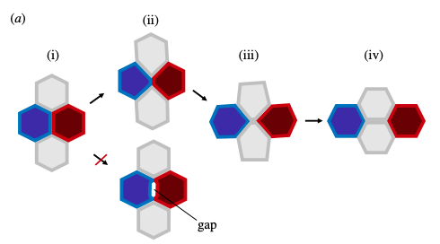
Do cells in invading spheroids migrate collectively?
Cells in invading spheroids migrate collectively but undergo neighbour exchange.
Neighbour exchange results from a topology change that occurs with the remodelling of cell-cell contacts.
Rauzi, Phil Transactions B 2020
Notes:
The second possibility is that cells in invading spheroids migrate collectively but undergo neighbour exchange, which results from a topology change that occurs with the remodelling of cell-cell contacts. Topology change occurs when a cell loses or gains new contact with neighbouring cells. Here is a 2D representation of cell intercalation, which is what happens during neighbour exchange. (i-ii): a cell junction shrinks, (ii)-(iii): a new junction forms, and (iii)-(iv): extends. This would explain the weak correlation between the direction of movement of cell neighbours because the cells are constantly rearranging themselves in the spheroids. Taking into account that individual cells are observed to undergo directed migration, this could be a plausible explanation for the results observed if the cells were to be migrating both collectively and in a single direction.
Cell intercalation: type 1 (T1) transition in foam physics
References:
1. Rauzi, M. (2020). Cell intercalation in a simple epithelium. Philosophical Transactions of the Royal Society B: Biological Sciences, 375(1809), 20190552. https://doi.org/10.1098/rstb.2019.0552

Slide 26
Conclusion
In invading spheroids, single cell directed migration is observed
Collective cell migration is not observed in invading spheroids, but this could be due to neighbour exchange
Regional differences in cell migration indicate that the bottom of spheroids undergo invasive spreading
Notes:
Collective cell migration is not observed in invading spheroids from my data alone, but this could either be due to neighbour exchange or imply that single cell directed migration can occur without collective cell migration.
Learning outcomes: work independently, integrate knowledge from difference Science disciplines (Physics, Cell Biology – these two are the basis of Mechanobiology)

Slide 27
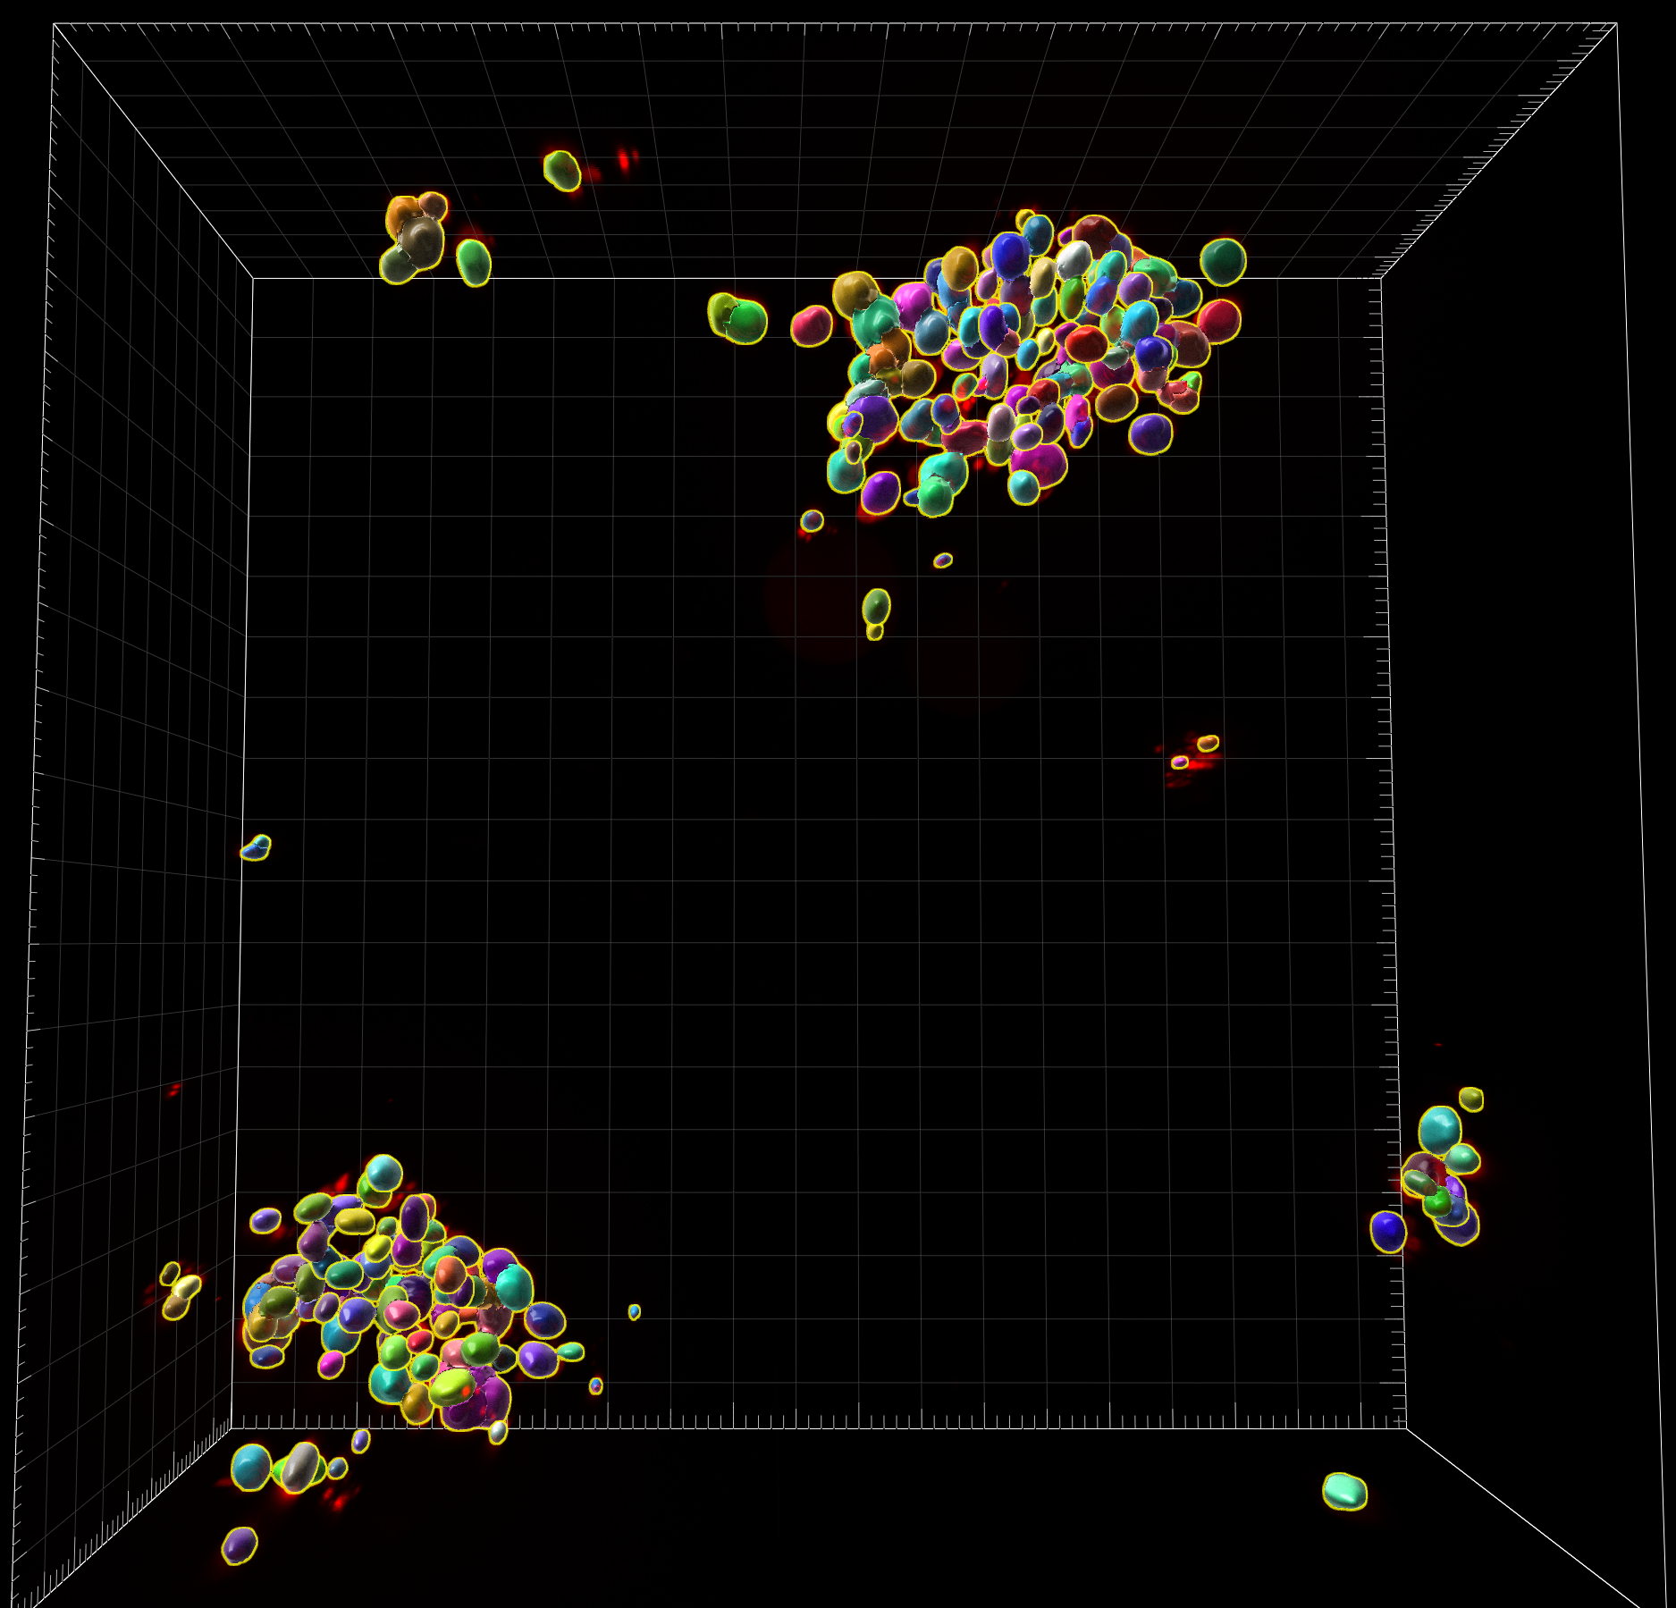
Future Work
Does cell number affect spheroid invasion?
GFP images
Cell segmentation using StarDist
GFP images and their labels
Identification of cancer spheroids and cell counting using Imaris
Investigate relationship between cell number and invasion efficiency
Notes:
Some possible future work that could be done to supplement my analysis would be to find out how cell number varies across samples and whether this affects spheroid invasion. This can be done by first, segmenting the cancer spheroids from their images to obtain labels identifying the cells, then followed by cell counting using Imaris.
Composite: red - image, green - label, correctly labelled nuclei – yellow
Image credit: Celestine

Slide 28
Acknowledgements
Prof Low Boon Chuan and his lab
Celestine and Daniella
Tetsuya and Yuting
Selwin
Notes:
Finally, I would like to acknowledge the assistance given to me by various individuals, including Prof Low Boon Chuan and his lab members, who gave me much-needed feedback during lab meetings, Celestine and Daniella, who did the segmentation and tracking prior to my analysis and provided some of the images and the movie in this presentation, Tetsuya and Yuting, who guided me on the Physics concepts and computational methods relevant to my analysis, and my mentor Selwin, who helped me better understand the biological significance of my project and was always ready to give me feedback.

Slide 29
Thank You!

Slide 30
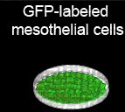
Experimental workflow
Cancer spheroids -
Aggregation and compaction
OVCA433 monolayer
Trypsin-free cell dissociation
Iwanicki et al., Cancer Discov. 2011
Davidowitz et al., JCI 2014
Kenny et al., JCI 2014
Morphology of tumour spheroid
Mina Bissell lab (founder of spheroid 3D cultures)
Molecular Oncology, 2007
Selwin and Celestine
Notes:
Ovarian cancer cell spheroids were cultured beforehand by Selwin and Celestine according to this workflow. Mesothelial cells were labelled using H2b-mNeon. Most tumour spheroids are mass or grape-like.
H2b-mNeon: Fusion protein consisting of histone 2B and a GFP alternative, used as a fluorescent nuclei marker
Slide credit: Selwin
References:
Kenny, P. A., Lee, G. Y., Myers, C. A., Neve, R. M., Semeiks, J. R., Spellman, P. T., Lorenz, K., Lee, E. H., Barcellos-Hoff, M. H., Petersen, O. W., Gray, J. W., & Bissell, M. J. (2007). The morphologies of breast cancer cell lines in three-dimensional assays correlate with their profiles of gene expression. Molecular Oncology, 1(1), 84–96. https://doi.org/10.1016/j.molonc.2007.02.004

Slide 31
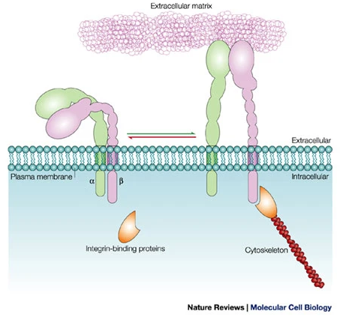
Proteins required for spheroid invasion/mesothelial clearance
OVCA 433 spheroids require myosin IIA and IIB to sustain mesothelial clearance
Ovarian cancer spheroids also utilize α5β1 integrin to dissociate fibronectin from the mesothelial monolayer during clearance
α5β1 integrin-dependent activation of myosin in ovarian cancer spheroids is required for mesothelial clearance
In the non-invading samples in this study, integrin α5 was knocked down in mesothelial cells using siRNA to prevent spheroid invasion as mesothelial integrin α5 is required for spheroid engagement
Iwanicki et al., Cancer Discov 2011
Kinbara et al., Nat Reviews 2003
Notes:
References:
1. Kinbara, K., Goldfinger, L. E., Hansen, M., Chou, F.-L., & Ginsberg, M. H. (2003). Ras GTPases: Integrins’ friends or foes? Nature Reviews Molecular Cell Biology, 4(10), 767–777. https://doi.org/10.1038/nrm1229

Slide 32
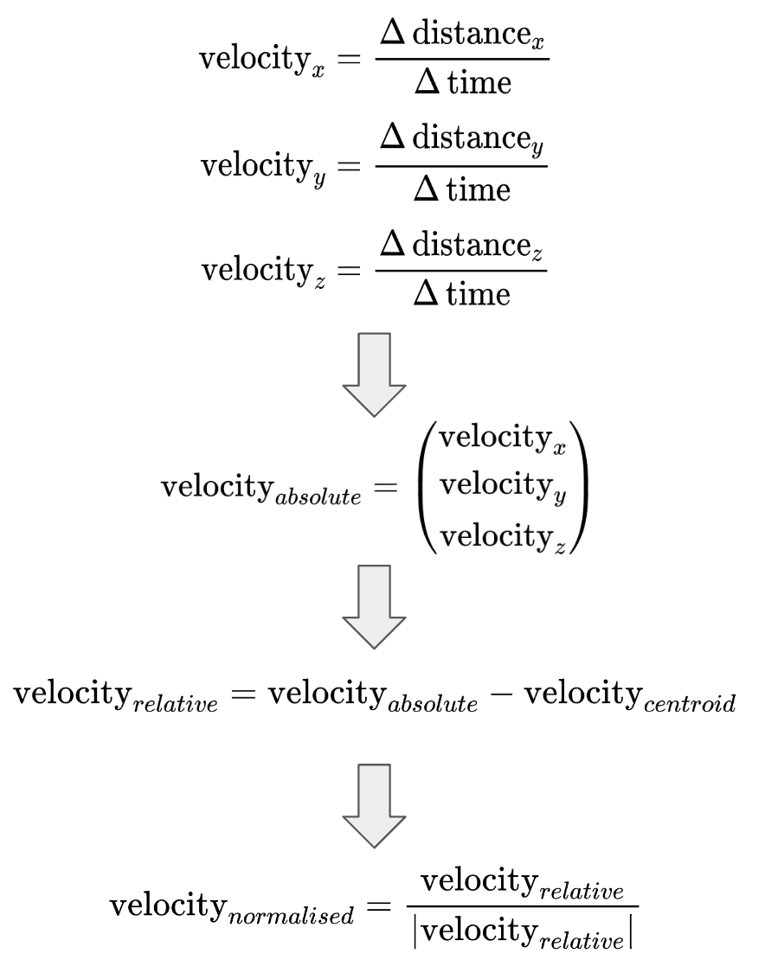
Velocity calculation

Slide 33
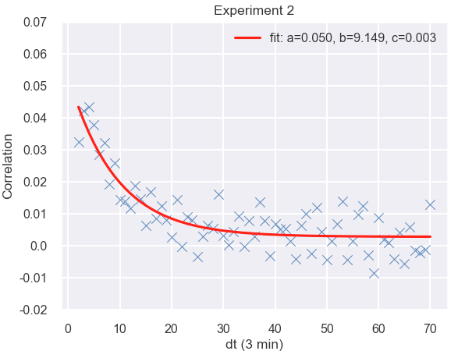
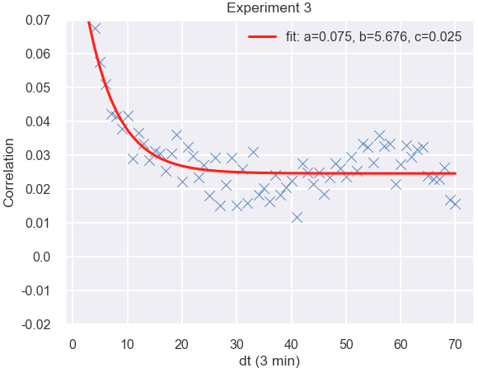
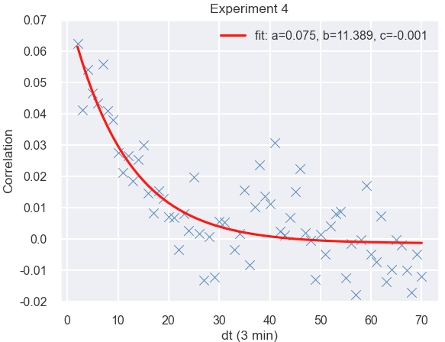
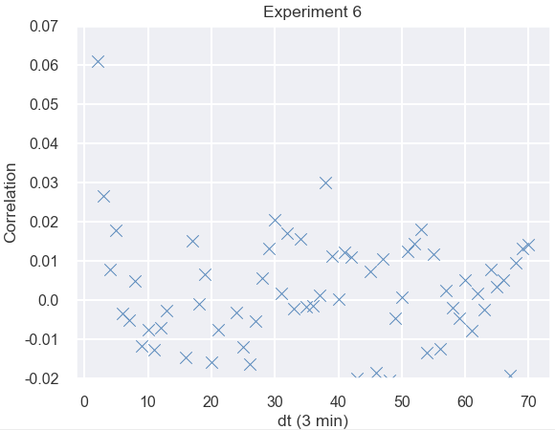
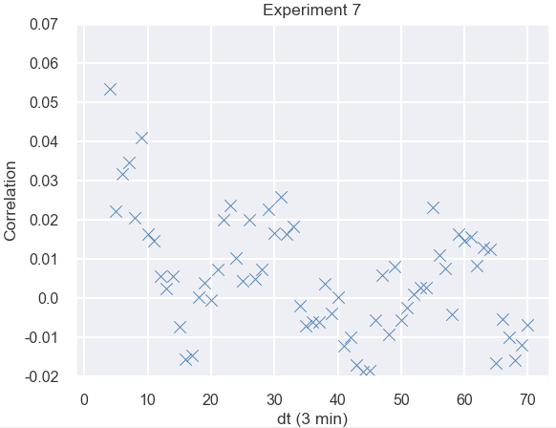
Temporal autocorrelation plots
Invading (fitted to )
Non-invading
Notes:
Experiment 5 seems like the outlier because we expect correlation values to be high at very low values of dt even for non-invading samples and near 0 for the rest of the values of dt.

Slide 34
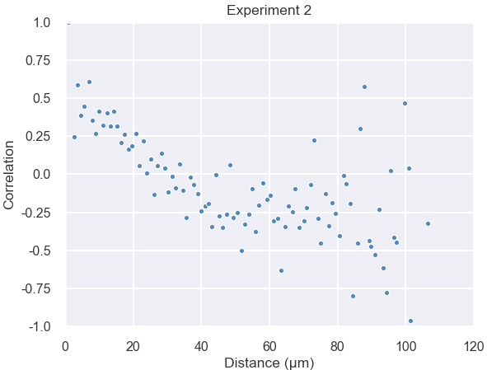
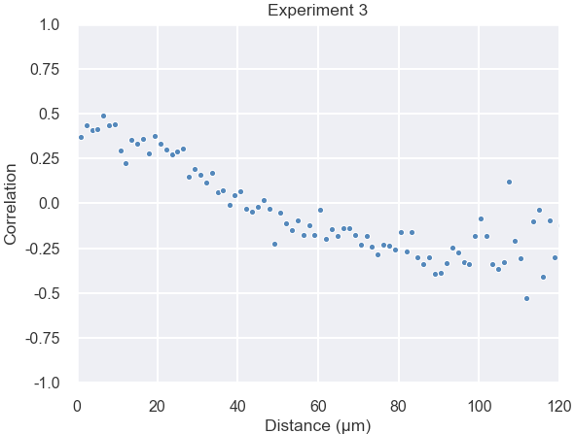
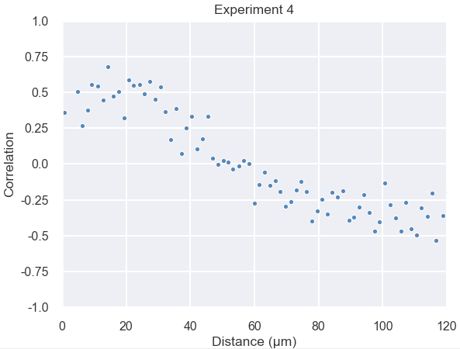
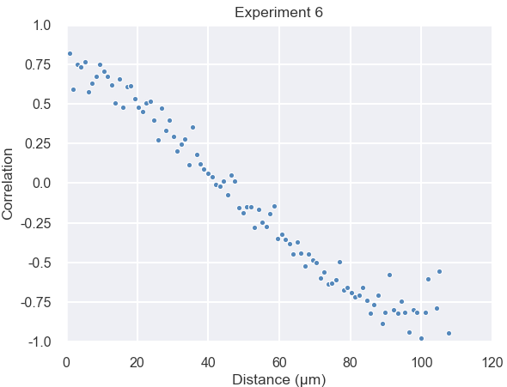
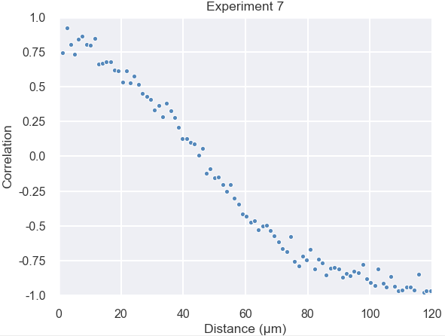
Spatial correlation plots
Invading
Non-invading
Notes:
Invading: 120th timepoint after invasion, non-invading: t=40 (approximately middle of experiment)

Slide 35
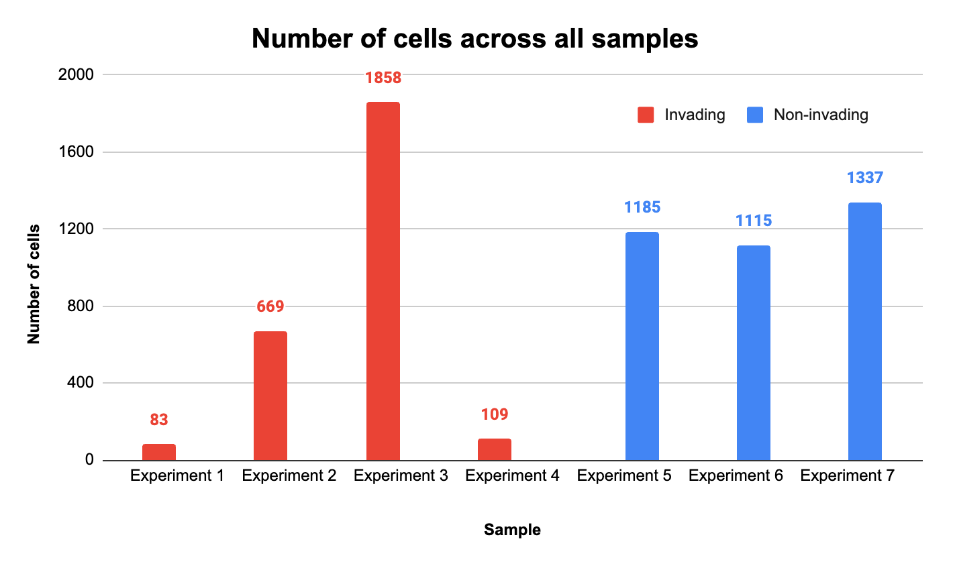
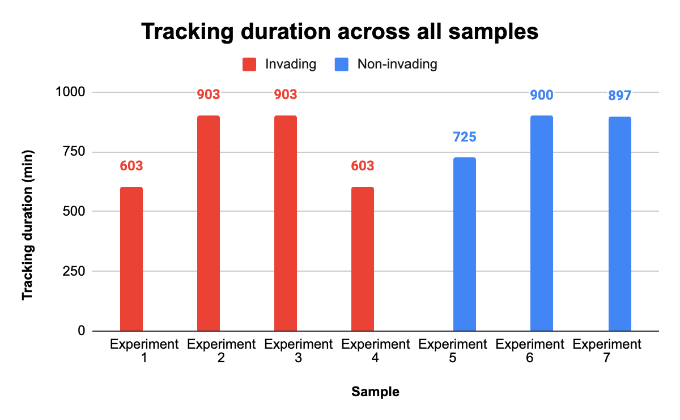
Preliminary data analysis
Notes:
To obtain a sense of how the data looked like, I plotted graphs to visualise the distribution of number of cells and tracking duration across all 7 samples. As shown in the bar plot on the left, the number of cells was rather varied across the samples. On the other hand, the plot on the right shows that tracking duration was generally similar between samples.

